Slide 1
SOCIAL DETERMINANTS OF HEALTH
Data Source: DOH Florida CHARTS, Florida Department of Education, and U.S. Census Bureau
Presentation developed by: Pam Beck, Operations Manager, Department of Health-Madison
Presented by: Pam Beck, Operations Manager, Department of Health-Madison

Slide 2
Introduction
The Social Determinants of Health were introduced to the public through the Healthy People 2020 initiative.
Healthy People 2020 Goal: Create social and physical environments that promote good health for all.
Healthy People 2020 Social Determinants of Health definition, “Conditions in the environments in which people are born, live, learn, work, play, worship, and age that affect a wide range of health, functioning, and quality-of-life outcomes and risks.”

Slide 3
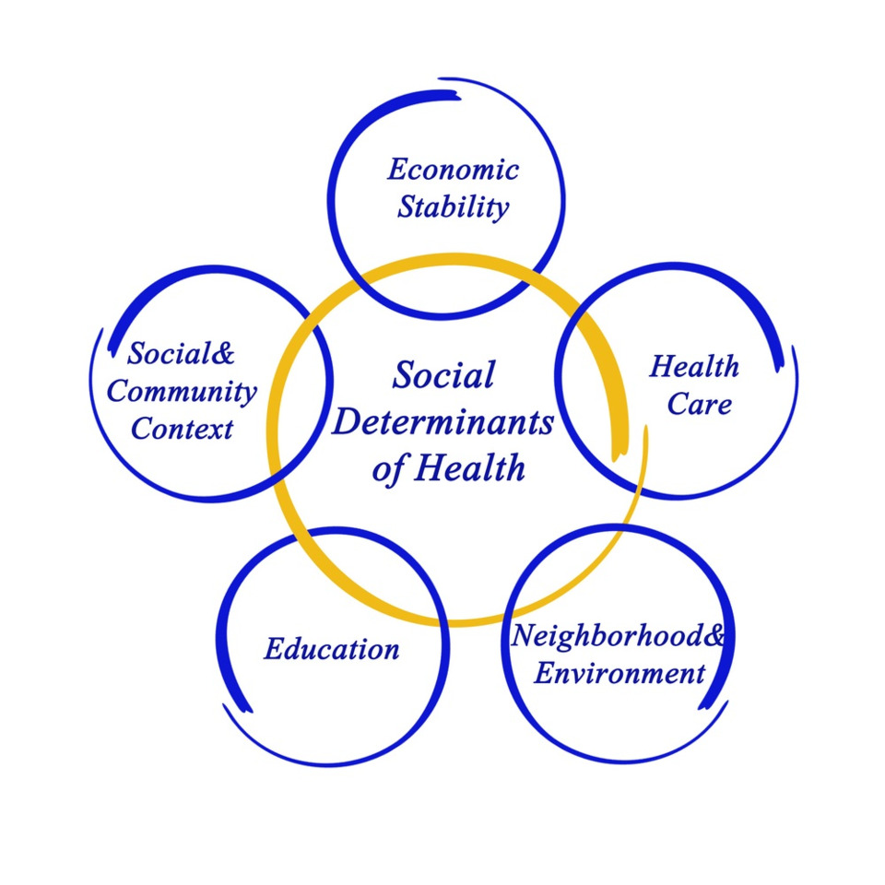
SDOH Categories
Healthy People 2020 social determinants can be condensed into the following categories:
  Education
  Economic Stability
  Social and Community Context
  Health & Health Care
  Neighborhood and Built Environment
The theory is that in order to fix health care, you have to fix these items first

Slide 4
Why is SDOH important?
Notes:
Income and poverty data are very high in Madison County
Food insecurity is an issue
Housing stability is an issue for Hispanics and Black, non-Hispanics
Early Steps Program is being underutilized compared to previous years
Large increase in elementary school children not promoted
Florida Standards Assessment scores are decreasing
Lack of health care insurance is an issue in two census tracts

Slide 5
ECONOMIC STABILITY
Data Source: DOH Florida CHARTS, Suburban Stats, University of Florida and U.S. Census Bureau

Slide 6
Economic Stability
Included in this category are:
  Employment
  Poverty
  Food Insecurity
  Housing Instability
Employment barriers to consider
  Persons who are unemployed or underemployed will most likely not have access to health insurance
  Persons who are unemployed or underemployed may also have issues with food insecurity, inadequate housing, access to medical services and transportation
Poverty barriers to consider
  Poverty can lead to issues with health insurance, food insecurity, inadequate housing, access to medical services and transportation
Notes:
Economic stability and education are the building blocks for the rest of the social determinants of health
Lack of employment leads to poverty, food insecurity and housing instability
Even if a household has food assistance, healthy foods are more expensive than junk foods so that is usually what is purchased

Slide 7
Economic Stability
Food insecurity barriers to consider
  Adults who are food insecure are more likely to be obese and suffer from chronic diseases
  Children who do not eat regularly or do not eat a variety of healthy foods are at risk for developmental and mental health issues, as well as obesity
Housing instability barriers to consider
  Families that pay too much for housing have less money for necessary expenses and health insurance
  Pregnant women who are homeless are more likely to have low birth-weight and preterm births.
  Home foreclosures and evictions can lead to suicides
  Children who are moved frequently have more chronic conditions
Notes:
Households are considered to be cost burdened if they spend more than 30% of their income on housing and severely cost burdened if they spend more than 50% of their income on housing
Moving 3 or more times in 1 year, often called “multiple moves,” has been associated with negative health outcomes in children

Slide 8
Economic and Poverty Data (2018)
Madison County
Individual Poverty
Madison County ranked 65th of 67 counties for median household income in 2018. Only two counties had a lower median household income. Madison County’s median income was $35,509, compared to $53,267 for the state as a whole.
The individual poverty rate for Madison County was the third highest in the state (28.2%) in 2018. The Madison rate was twice that of Florida as a whole (14.8%).
The percent of related children under the age of 18 in families in poverty for Madison County in 2018 was 37%, compared to 17.3% for Florida.

Slide 9
Economic and Poverty Data (2018)
Madison County
Families in Poverty
51.9% of individuals in Madison County were living below 200% poverty level, compared to 35.4% for Florida.
Approximately 35.8% of persons ages 65+ in Madison County were living below 150% poverty level, compared to 20.6% of the state as a whole.
43.3% of Madison County individuals under age 18 were living below poverty level in 2018, compared to 21.3% for Florida

Slide 10
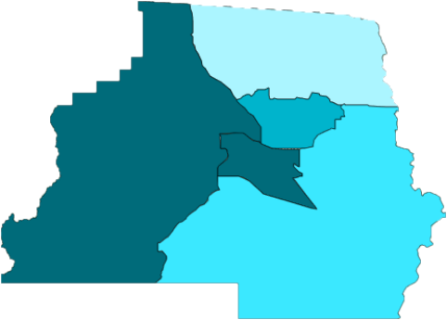
Poverty Data by Census Tract (2014-2018)
Madison County
 | 1104 | 1102 | 1101 | 1103.01 | 1103.02
Median income ($) | 41,181 | 33,191 | 41,579 | 40,313 | 29,886
People under 100% of poverty (%) | 20.3 | 36.3 | 16.4 | 28.8 | 35.8
Families under 100% poverty (%) | 19.6 | 24.8 | 15.9 | 21.5 | 26.5
Female HOH families under 100% poverty (%) | 60.3 | 42.5 | 21.1 | 38.5 | 62.7
1101
Highest percent of people under 100% poverty
1103.01
Lowest median income
Highest percent of families
under 100% poverty and female HOH families under 100% poverty
1102
1103.02
1104

Slide 11
Unemployment Rates, 2000-2018
Madison County and Florida
The 2018 unemployment rate for Madison County was 3.9%,
compared to 3.6% for the state as a whole

Slide 12
Food Insecurity Rate, 2014-2017 (Percent of Population), Madison County and Florida
Notes:
The percentage of the population that does not have consistent access to enough food for an active, healthy life. Food insecurity refers to a lack of available financial resources for food at the household level.
Low-income families are affected by multiple, overlapping issues like lack of affordable housing, social isolation, chronic or acute health problems, high medical costs, and low wages. People experiencing food insecurity often consume a nutrient-poor diet, which may contribute to the development of obesity, heart disease, hypertension, diabetes, and other chronic diseases.
Madison County’s rate has remained fairly consistent over the past four years.
Data Source: Feeding America, Map the Meal Gap.

Slide 13
Child Food Insecurity Rate, 2014-2017 (Percent of Population), Madison County and Florida
Notes:
The percentage of the children under 18 years old that do not have consistent access to enough food for an active, healthy life.

Slide 14
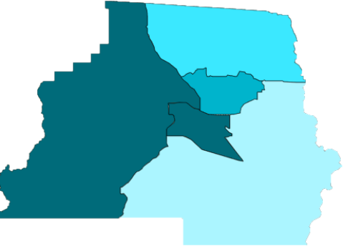
Cash and Food Assistance, 2014-2018 by Census Tract, Madison County
 | 1104 | 1102 | 1101 | 1103.01 | 1103.02
% Population with Supplemental Security Income | 3.4 | 7.9 | 13.0 | 12.4 | 10.0
% Population with Cash Public Assistance Income | 2.0 | 2.1 | 0.8 | 0.0 | 1.4
% Population with Food Stamp/SNAP Benefits | 10.4 | 21.4 | 12.7 | 13.2 | 36.2
Highest percent of population
with Supplemental Security Income
1101
Highest percent of population
with cash public assistance income
1103.01
Highest percent of population
receiving food stamps/SNAP
1102
1103.02
1104

Slide 15
Individuals that Lived in a Different House 1 Year Earlier, 2009-2018, Madison County and Florida
The percent of persons living in a different house the year prior increased from 12.9% in 2017 to 13.1% in 2018 in Madison County.
This is slightly below the state of Florida at 14.4% and 14.3% respectively.
2018 by race/ethnicity
  Hispanics represented 16.4% in Madison and 13.7% in Florida
  White NH accounted for 8.0% in Madison and 13.5% in Florida
  Black NH represented 19.4% in Madison and 16.4% in Florida
Notes:
Department of Education homeless record count as of 12/27/2018 was 169 children.
Data not yet available from the Point-in-time count on 1/28/2020

Slide 16
EDUCATION DATA
Data Source: DOH Florida CHARTS, DOE Education Information and Accountability Services

Slide 17
Education
Included in this category are:
  Early Childhood Education and Development
  Enrollment in Higher Education
  High School Graduation
  Language and Literacy
Early childhood education and development barriers to consider
  Children who do not receive early childhood education are less likely to read at grade level. This can lead to literacy and health literacy issues later in life.
Enrollment in higher education barriers to consider
  Lack of higher education can mean lesser-paying jobs with more safety hazards
  Lack of higher education can result in lower quality housing
  If literacy level is low, knowledge about health is also low
  If parents did not attend college, it is less likely that the child will
Notes:
Racial and ethnic minorities may face unique barriers to higher education. African American and Hispanic individuals have lower college enrollment and graduation rates compared to whites, and Latinos are most likely to attend college part-time, which reduces their odds of graduating. One study found that 3 in 4 Latino college students were not academically prepared for coursework. Recent evidence has shown that African American college students accumulate more federal education debt than students of other ethnicities

Slide 18
Education
High school graduation barriers to consider
  Persons who do not graduate from high school are less likely to obtain employment that will support them and/or their families.
  High schools with less funding rarely provide advanced or honors classes
Language and literacy barriers to consider
  Health literacy is linked to overall literacy

Slide 19
Percent of Children <3 Served by
Early Steps, Madison County and Florida
Notes:
The Early Steps Program serves infants and toddlers under three years of age who have developmental delays or an established condition likely to result in a developmental delay. Examples of these conditions are autism spectrum disorder, cerebral palsy, Down syndrome, deafness and hard of hearing and visual impairment.
Why do we measure this?
Positive early learning experiences are crucial for later success in school, the workplace and the community. Early intervention services positively impact outcomes across children’s developmental domains: physical, cognitive, communication, social or emotional and adaptive. Families benefit from early intervention by being able to better meet their children’s needs and enhance their unique abilities from an early age. Early intervention services also benefit the community and society, for example, by lowering the costs of special education and social welfare programs.

Slide 20
Percent of Elementary School Students Not Promoted, 2000-2018, Madison County and Florida
The percent of Madison County elementary school students not promoted increased to 12.9% in 2018 from 5.7% in 2017
Florida’s percent of elementary school students not promoted was 3.4% for 2017 and 3.2% in 2018
Data are not available by gender or race/ethnicity
Notes:
The time periods for these slides are school years, such as 2000-2001 (August 2000-May 2001)

Slide 21
3rd Grade FSA Passing Scores for English and Mathematics, Madison County and Florida
School Year | Madison County (%) | Florida (%)
2014-15 | 43 | 54
2015-16 | 47 | 54
2016-17 | 55 | 58
2017-18 | 55 | 57
2018-19 | 40 | 58
English/
Language Arts
School Year | Madison County (%) | Florida (%)
2014-15 | 40 | 59
2015-16 | 63 | 61
2016-17 | 66 | 62
2017-18 | 60 | 62
2018-19 | 45 | 62
Mathematics
Notes:
The percent of students achieving a passing level of 3 or above on the Florida Standards Assessments for English Language Arts and Mathematics

Slide 22
Percent of Middle School Students Not Promoted 2000-2018, Madison County and Florida
The percent of Madison County middle school students not promoted decreased from 2.1% in 2017 to 1.7% in 2018
Florida’s percent of middle school students not promoted decreased from 1.8% in 2017 to 1.6% in 2018
Data are not available by gender or race/ethnicity

Slide 23
High School Graduation Rates
2011-2018, Madison County and Florida
Madison County’s graduation rate increased from 76.7% in 2017-18 to 82.5% in 2018-19
Florida’s graduation rate increased slightly from 86.1 % in 2017-18 to 86.9% in 2018-19

Slide 24
Graduation Rates by Demographics, 2018-2019 Madison County and Florida
Gender | Madison County (%) | Florida (%)
Male | 81.9 | 83.9
Female | 83.2 | 90.0
Race/Ethnicity | Madison County (%) | Florida (%)
Black, non-Hispanic | 75.2 | 81.5
White, non-Hispanic | 89.1 | 90.2
Hispanics not recorded for Madison County
Disability Status | Madison County (%) | Florida (%)
Disabled | 73.3 | 80.6
Not Disabled | 84.1 | 87.7
Disadvantaged Status | Madison County (%) | Florida (%)
Disadvantaged | 74.8 | 82.9
Not Disadvantaged | 90.5 | 91.7
Notes:
Florida's high school graduation rate is the percentage of students who graduated within four years of their initial enrollment in ninth grade, not counting deceased students or students who transferred out to attend another public school outside the system, a private school, a home education program, or an adult education program. Incoming transfer students are included in the appropriate cohort (the group whose progress is tracked) based on their grade level and year of entry.
Disadvantaged/Not Disadvantaged refers to economic status. Disadvantaged students are students determined to be eligible for free and reduced price meals under the National School Lunch Program
Disabled/Not Disabled refers to students with or without a disability. Section 1007.02, F.S., defines “student with a disability” as a student who is documented as having an intellectual disability; a hearing impairment, including deafness; a speech or language impairment; a visual impairment, including blindness; an emotional or behavioral disability; an orthopedic or other health impairment; an autism spectrum disorder; a traumatic brain injury; or a specific learning disability, including, but not limited to, dyslexia, dyscalculia, or developmental aphasia.

Slide 25
Madison County Education Data, 2018
38.1% of county residents over age 25 had a high school diploma in 2018, compared to 28.8% for the state
Madison County residents are less likely to pursue college degrees (13.8% in 2018) compared to the state (29.2%)
In Madison County, 18.1% of White residents had a bachelor’s degree or higher in 2018, followed by 7.4% of Black residents and 10.5% of Hispanic residents

Slide 26

Education Data by Census Tract, 2014-2018
Percent of Population, Madison County
 | 1103.02 | 1104 | 1101 | 1102 | 1103.01
Less than 9th grade | 6.0 | 3.8 | 4.2 | 7.2 | 4.9
Some high school | 20.6 | 11.5 | 7.6 | 13.3 | 10.1
High school graduate | 39.7 | 39.6 | 35.3 | 38.9 | 34.1
Some college | 16.0 | 23.8 | 18.3 | 11.5 | 21.6
Associates degree | 5.5 | 13.3 | 17.3 | 16.0 | 19.3
Bachelor’s degree | 3.6 | 7.5 | 14.5 | 10.7 | 12.2
Graduate degree | 8.6 | 0.6 | 2.8 | 5.3 | 7.0
Highest percent
of persons with
less than 9th grade
education
1101
1103.01
1102
1103.02
1104
Persons ages 25 and older
Highest percent of persons
with graduate degrees

Slide 27
Social & Community Context

Slide 28
Social and Community Context
Included in this category are:
  Discrimination
  Incarceration
  Social Cohesion
Discrimination barriers to consider
  Discrimination can affect employment opportunities, access to care and access to adequate housing
  Discrimination can result in toxic stress which leads to negative infant outcomes and cardiovascular issues

Slide 29
Social and Community Context
Incarceration barriers to consider (injury and violence section)
  Persons who were incarcerated have less chance of obtaining gainful employment
  Persons who were incarcerated and have addictions issues may have health issues related to the addiction
  Continuity of care for health conditions when incarcerated and released
Social cohesion barriers to consider
  Social networks can spread health behaviors, also known as social contagion. Examples are smoking, drinking and eating behaviors
  Lack of social cohesion can lead to isolation, insomnia and emotional stress

Slide 30
Racial Residential Segregation, 2015-2018 Madison County and Florida
When the Racial Segregation Index is less than 0.3 the county’s population is “well integrated.”
Values between 0.3 and 0.6 indicate the county’s population is “moderately segregated.”
Values above 0.6 indicate the county’s population is “very segregated.”
Notes:
Racial residential segregation as measured through the Dissimilarity Index, the differential distribution of individuals by race or other social or income factors. When the Racial Residential Segregation Index is less than 0.3 the county’s population is “well integrated”. Values between 0.3 and 0.6 indicate the county’s population is “moderately segregated”. Values above 0.6 indicate the county’s population is “very segregated.”

Slide 31
Health & Healthcare
Data Source: DOH Florida CHARTS, CMS

Slide 32
Health and Health Care
Included in this category are:
  Access to Health Care
  Access to Primary Care
  Health Literacy
Access to health care barriers to consider
  Inadequate health insurance can result in lack of health care
  Lack of insurance and/or high out-of-pocket costs means less preventive care
  Lack of transportation means emergency only care
  Physician shortages can mean longer wait times and delayed care
Notes:
I included transportation under access to care

Slide 33
Health and Health Care
Access to primary care barriers to consider
  Limited or no access to primary care means less preventive health services and no early detection of health care issues
Health literacy barriers to consider
  Persons who do not speak English are less likely to receive health care services and preventive screenings

Slide 34
Medicaid Eligibility and Insurance Information, Madison County
17% of adults are uninsured in Madison County
6% of children are uninsured in Madison County
Percentage of Medicaid-eligible persons similar to the state

Slide 35
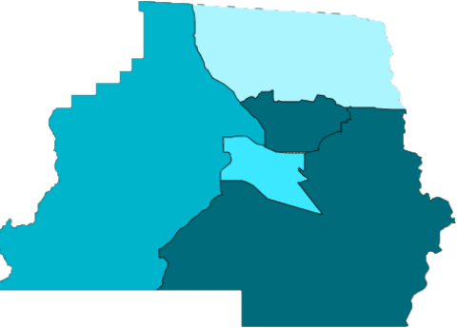
Health Care Coverage by Census Tract
Madison County, 2014-2018 (% of Population)
 | 1103.02 | 1104 | 1101 | 1102 | 1103.01
With private health insurance | 47.8 | 57.7 | 64.4 | 48.5 | 57.7
With public health insurance | 52.8 | 44.1 | 43.3 | 51.9 | 44.2
No health insurance coverage | 11.0 | 14.1 | 10.9 | 12.6 | 19.5
<19 years of age no health insurance | 4.0 | 5.4 | 5.1 | 6.2 | 19.2
Highest percentage
of persons <19 with no
health insurance
1101
1103.01
1102
1103.02
Highest percentage
of persons with no
health insurance
1104

Slide 36
Built Environment &
HOUSING DATA
Data Source: DOH Florida CHARTS, US Bureau of the Census, American Community Survey

Slide 37
Neighborhood and Built Environment
Included in this category is:
  Crime and Violence
  Environmental Conditions
  Quality of Housing
Crime and violence barriers to consider
  Violence can lead to premature death, physical pain, mental distress and reduced quality of life
  People who fear crime may not go out to exercise
  Child and adolescent exposure to violence can result in greater risk for substance abuse, risky sexual behavior
  Sexual partner violence can lead to physical injuries and mental health issues such as eating disorders, depression and suicide

Slide 38
Neighborhood and Built Environment
Environmental conditions barriers to consider
  Poor water quality can lead to illnesses such as Giardia
  Poor air quality can lead to cardiovascular issues
  Poor air quality can lead to issues with fetal and child development
  Lack of air conditioning can lead to heat-related disease and death
Quality of housing barriers to consider
  Substandard housing may have health risks like vermin, water leaks, mold, heat and AC issues

Slide 39
Median Owner-Occupied Unit Values, 2009-2018, Madison County and Florida
Madison County’s owner-occupied home values are well below the state.
There was a slight increase from $87,200 in 2017 to $87,400 in 2018 in Madison County.
The median value of owner-occupied homes in Florida in 2018 was $196,800.

Slide 40
Owner-Occupied Housing Units, Percent of Occupied Housing Units, 2009-2018, Madison County and Florida
Madison County has consistently had higher percentages of owner-occupied housing units than the state.
2018 percentages by race/ethnicity
  Hispanics - 78.6% in Madison compared to 51.0% Florida
  White NH - 84.2% in Madison and 69.3% in Florida
  Black NH - 66.9% in Madison and 44.5% in Florida
Notes:
This means that Madison County has less residents that own more than one housing unit than the state.

Slide 41
Housing Quality
 | 1103.02 | 1104 | 1101 | 1102 | 1103.01
Percent of homes lacking complete plumbing facilities | 0.0 | 0.0 | 0.0 | 0.0 | 1.4
Percent of homes lacking kitchen facilities | 2.0 | 0.0 | 1.4 | 0.0 | 1.4
Percent of homes heated with electricity | 71.2 | 82.4 | 82.6 | 86.3 | 80.6
Percent of homes heated with utility gas | 20.4 | 0.5 | 0.0 | 2.4 | 4.4
Percent of homes heated with bottled, tank or LP gas | 7.7 | 12.7 | 10.6 | 7.2 | 11.6
Percent of homes heated with fuel oil, kerosene | 0.0 | 0.5 | 2.4 | 0.0 | 2.2
Percent of homes heated with wood | 0.0 | 3.4 | 3.6 | 3.6 | 1.3
Percent of homes not heated | 0.7 | 0.6 | 0.7 | 0.5 | 0.0
Notes:
Statewide, 0.3% of homes lacked complete plumbing facilities and 0.2% in Madison County
In Florida, 0.7% of homes lacked kitchen facilities and 0.9% in Madison County.
Electricity was the primary means of heat for both Florida and Madison County.
Madison County has a higher percent of homes using utility gas or bottled gas and a far higher percent of homes using wood to heat the home.

