Slide 1
POPULATION DATA
Data Source: DOH Florida CHARTS, and U.S. Census Bureau
Presentation developed by: Pam Beck, Operations Manager, Department of Health-Madison
Presented by: Kaitlynn Culpepper, Public Relations Director Tri County Electric & Chair Chamber of Commerce

Slide 2

Population Trends (2010-2018)
Madison County and Florida
Average population over the nine years is 19,287
Madison County population decreased during 2014-2015 and has now increased to 2013 levels
Population estimates indicate a slight decrease (0.3%) for 2019

Slide 3
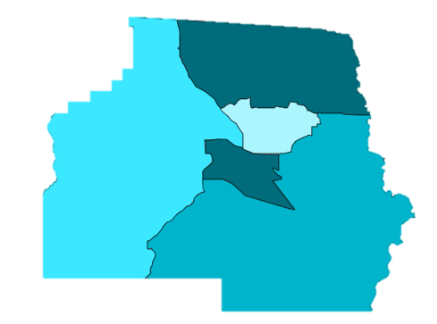
2014-2018 Population by Census Tract
Madison County
1101
16%
1103.01
1102
12%
20%
1103.02
32%
1104
20%
Notes:
Nearly half of the county’s population (44%) reside in tracts 1103.02 and 1103.01.

Slide 4
Madison County Demographics (2018)
Slightly more males (53%) than females (47%)
6% identified as Hispanic, regardless of race, compared to 26% for the state of Florida
Median age was 42.9; slightly higher than Florida at 41.9
Notes:
The percent of population for Hispanics grew 2% in one year in Madison County.

Slide 5
2014-2018 Demographics by Census Tract
Percent of Total Population, Madison County
Race | 1103.02 | 1104 | 1101 | 1102 | 1103.01
White | 37.9 | 78.3 | 82.3 | 50.7 | 56.5
Black | 60.0 | 17.3 | 16.8 | 44.2 | 36.3
Other | 1.8 | 2.9 | 0.5 | 4.6 | 6.2
Multiracial | 0.4 | 1.5 | 0.3 | 0.5 | 0.9
Hispanic (All Races) | 7.8 | 5.3 | 3.5 | 1.2 | 7.2
Gender | 1103.02 | 1104 | 1101 | 1102 | 1103.01
Males | 64.9 | 47.9 | 46.4 | 49.6 | 44.9
Females | 35.1 | 52.1 | 53.6 | 50.4 | 55.1
Notes:
The percentage of Hispanics was highest in tract 1103.02

Slide 6
2014-2018 Demographics by Census Tract
Percent of Total Population, Madison County
Age Group | 1103.02 | 1104 | 1101 | 1102 | 1103.01
< 5 | 4.9 | 5.8 | 3.3 | 5.8 | 4.6
5-9 | 6.1 | 6.2 | 8.4 | 4.3 | 2.2
10-14 | 3.6 | 7.0 | 1.6 | 7.5 | 6.3
15-19 | 5.7 | 5.7 | 6.0 | 5.9 | 9.2
20-24 | 7.1 | 1.2 | 4.1 | 9.0 | 2.8
25-34 | 18.8 | 13.5 | 15.1 | 8.4 | 8.1
35-44 | 15.8 | 9.6 | 8.4 | 9.9 | 11.8
45-54 | 15.0 | 13.2 | 10.8 | 13.3 | 13.0
55-59 | 6.7 | 5.9 | 7.3 | 8.7 | 8.3
60-64 | 3.3 | 9.5 | 8.8 | 7.0 | 9.3
65-74 | 5.9 | 16.4 | 15.4 | 10.9 | 16.0
75+ | 7.1 | 5.8 | 10.8 | 9.3 | 8.4
Notes:
Highest number of school age children (<5-19) = tracts 1103.02 (957) and 1104 (734)
Highest number of women of childbearing age = tracts1103.02 (1,034) and 1102 (650)
Highest number of seniors ages 65+ = tracts 1104 (862) and 1101 (814)

Slide 7
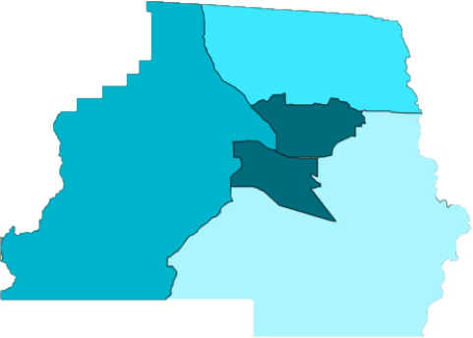
Percent of Households with No Vehicle
2014-2018, Madison County
Census Tract | Percent of Households
1103.02 | 24.8
1104 | 2.0
1101 | 7.6
1102 | 8.7
1103.01 | 14.0
1101
1103.01
1102
1103.02
1104

Slide 8
Transportation to Work, Ages 16+, 2018
Madison County and Florida
Method | Madison | Florida
Carpooled in Car, Truck or Van | 8.0 | 9.2
Drove Alone in Car, Truck or Van | 83.5 | 79.4
Used Public Transportation | 0.5 | 1.9
Used Taxicab, Motorcycle, Bicycle or Other Means | 3.1 | 2.2
Walked to Work | 2.4 | 1.4
Worked at Home | 2.6 | 5.8

