Slide 1
MATERNAL AND CHILD HEALTH
Data Source: DOH Florida CHARTS, Healthy Start Coalition
Presentation developed by: Pam Beck, Operations Manager, Department of Health-Madison
Presented by: Kimberly Albritton, Administrator, Department of Health-Madison or Donna Hagan, Healthy Start

Slide 2
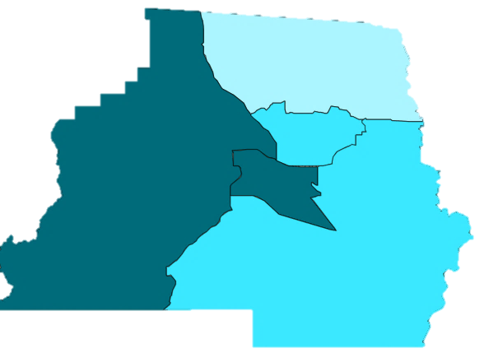

Infant Death 3-Year Rolling Rates per 1,000 Live Births (2000/02 – 2015/17)
Infant mortality by census tract
2013-2017
1101
1103.01
1102
1103.02
1104
Highest infant mortality
rates

Slide 3
Madison County Infant Mortality 2010-2017
Total Infant Mortality (0-364 Days)
Total of 17 deaths during the time frame
2 of these were White, non-Hispanic, 14 were Black, non-Hispanic or Other and 1 was Hispanic
Neonatal Mortality (0-27 Days) – Subset of Total Infant Mortality
11 Black, non-Hispanic or Other and 1 was Hispanic
Post Neonatal Mortality (28-364 Days) – Subset of Total Infant Mortality
2 of these were White, non-Hispanic and 3 were Black, non-Hispanic or Other

Slide 4
Percentage of Total Births Classified as Preterm (2000 – 2017)
The percent of births that were preterm in 2017 was higher (13.2%) compared to the state (10.3%)
19% of births to non-white mothers were considered preterm in 2017, compared to 10.4% for white mothers
Preterm birth < 37 weeks

Slide 5
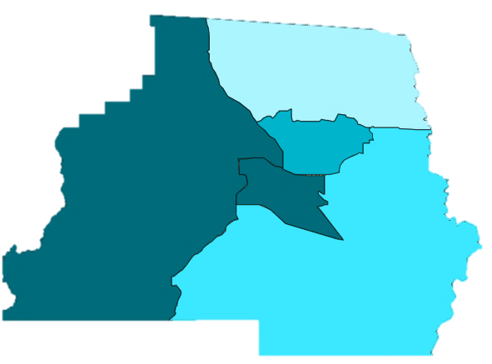
Preterm Births, Madison County
Madison County 2010-2017
Madison Total Preterm Births = 215 of 1,631 total births, or 13%
84, or 10%, of the 816 births to White, non-Hispanic women were preterm
126, or 17%, of the 750 births to Black, non-Hispanic women were preterm
5, or 8%, of the 65 births to Hispanic women were preterm
Preterm births by Census Tract
2013-2017
1101
1103.01
1102
1103.02
1104
Highest percent of
preterm births

Slide 6
Percent of Total Births Low Birth Weight (2000 – 2017), Madison County and Florida
The percent of births that were low birth weight in 2017 was higher (11%) compared to the state (8.0%)
16.5% of births to Black, non-Hispanic mothers were considered low birth weight in 2017, compared to 5.2% for White, non-Hispanic mothers
There were no Hispanic low birth-weight births in 2017
Low birth weight < 2500 grams

Slide 7
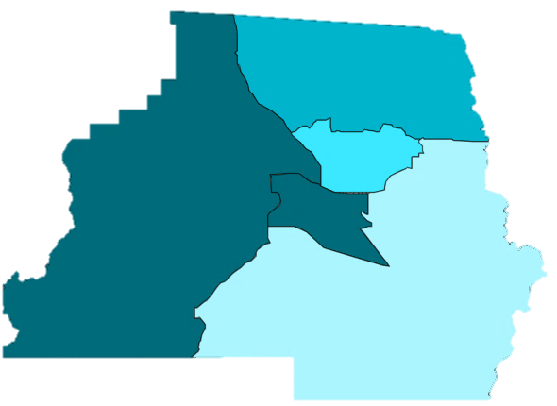
Madison County Low Birth-Weight Births
Madison 2010-2017
Madison Total LBW Births = 199 of 1,631 total births, or 12%
66, or 8%, of the 816 births to White, non-Hispanic women were LBW
129, or 17%, of the 750 births to Black, non-Hispanic women were LBW
4, or 6%, of the 65 births to Hispanic women were LBW
Low birth-weight births by Census Tract
2013-2017
1101
1103.01
1102
1103.02
1104
Highest percent of
low birth-weight births

Slide 8
Percent of Total Births Very Low Birth Weight (2000 – 2017)
Madison 2010-2017
Madison Total VLBW Births = 55 of 1,631 total births, or 3%
15, or 2%, of the 816 births to White, non-Hispanic women were VLBW
39, or 5%, of the 750 births to Black, non-Hispanic women were VLBW
1, or 2%, of the 65 births to Hispanic women were VLBW
Very low birth weight < 1500 grams

Slide 9
Percentage of Total Births to Mothers With 3rd Trimester Prenatal Care or No Prenatal Care
7.8% of births in 2017 had late or no prenatal care, compared to 6.9% for Florida
Madison 2010-2017
7%, of the births to White, non-Hispanic women had late or no prenatal care
9%, of the births to Black, non-Hispanic women had late or no prenatal care
13%, of the births to Hispanic women had late or no prenatal care

Slide 10
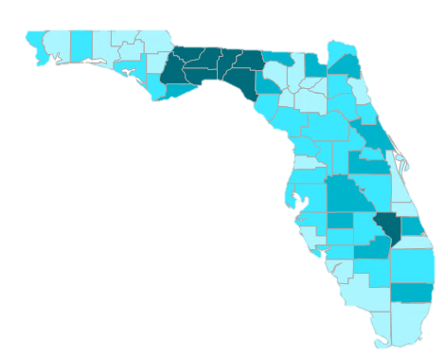

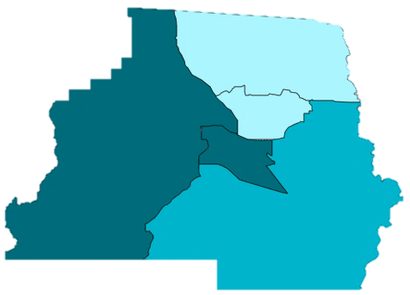
Percentage of Total Births to Mothers With 3rd Trimester Prenatal Care or No Prenatal Care
These data are being evaluated for accuracy by comparing health department and Healthy Start client data to data collected by birth clerks at the delivering facility
The state graphic shows that the areas being serviced by Tallahassee hospitals have the lowest prenatal care and the lowest breastfeeding initiation rates in the state
Highest percent of
late or no prenatal care
2013-2017
1101
1102
1103.01
1103.02
1104

Slide 11
Percent of Births Covered by Medicaid 2004-2017, Madison County
In 2017, the percent of births covered by Medicaid in Madison County was 25% higher than the percent of births for Florida
Madison 2010-2017 (73% overall)
65% of White NH Births
86% of Black NH Births
20% of Hispanic Births

Slide 12
Women Overweight or Obese at the Time of Pregnancy, 2004-2017

Slide 13
WIC Eligibles Served, 2000-2017 Madison County and Florida
Madison County’s percent of WIC eligible women served in 2017 was 60.7%, compared to 69.3% for Florida
The highest percentage attained was 95% in 2010.
Further study of location of WIC eligible women in Madison County versus WIC service location will be performed

Slide 14
Percent of Deliveries by C-Section 2000-2017, Madison County and Florida
The percent of deliveries by C-section are lower for Madison County than the state of Florida
In 2017, 32.6% of deliveries were via C-section in Madison County and 37.2% for Florida
Madison 2010-2017 (32% overall)
34% of White NH Births
32% of Black NH Births
31% of Hispanic Births

Slide 15
Births with Inter-Pregnancy Interval < 18 Months, Madison County and Florida
The annual percent of repeat births with less than 18 months between pregnancies in Madison County is close to the state of Florida
Madison Data for 2017
40% of repeat births to White, non-Hispanic mothers
34% of repeat births to Black, non-Hispanic mothers
0% of repeat births to Hispanic mothers

Slide 16
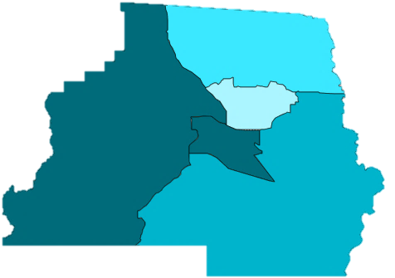
Births with Inter-Pregnancy Interval < 18 Months, Madison County
Madison 2010-2017
Madison Total = 291 of 803 total births, or 36% < 18 months apart
160, or 40%, of the 405 births to White, non-Hispanic women were <18 months apart
115, or 32%, of the 363 births to Black, non-Hispanic women were <18 months apart
16, or 46%, of the 35 births to Hispanic women were < 18 months apart
Births with <18 Month Interval by Census Tract
2013-2017
1101
1103.01
1102
1103.02
1104
Highest percent of births with interval
< 18 months
Denominators are the number of women giving birth for the second or greater time

Slide 17
Percent of Mothers Who Initiate Breastfeeding, Madison County and Florida
Madison 2010-2017 (61% overall)
73% of White NH Women initiated breastfeeding during the time frame, followed by 46% of Black NH Women and 71% of Hispanic Women
These data are also being compared for accuracy

Slide 18
Births to Mothers Ages 15-19 (2010 – 2017)
Year | <=14 | 15-17 | 18-19
2010 | 0 | 6 | 15
2011 | 0 | 5 | 15
2012 | 0 | 10 | 18
2013 | 2 | 1 | 16
2014 | 0 | 1 | 9
2015 | 1 | 5 | 10
2016 | 0 | 2 | 15
2017 | 0 | 3 | 8
There were 17 births in 2016 and 11 in 2017 to mothers ages 15-19
There were no births to mothers under the age of 15 in 2016 or 2017
The majority of births were to mothers ages 18-19 for both years; 88% in 2016 and 73% in 2017

Slide 19
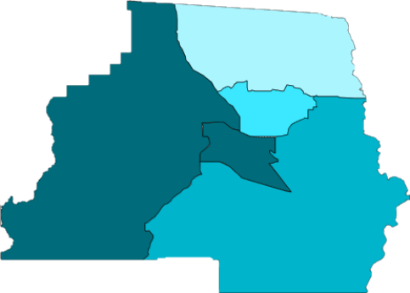
Births to Mothers Less Than Age 20 2013-2017, Madison County Census Tracts
2010-2017 Madison County
There were 142 births to mothers ages <20 during this time frame
44% were White, non-Hispanic
53% were Black, non-Hispanic
3% were Hispanic
Births to Mothers Less Than Age 20
by Census Tract, 2013-2017
1101
1103.01
1102
1103.02
1104
Highest percent of births to mothers < 20

Slide 20
Percent of Deliveries by C-Section 2000-2017, Madison County and Florida
Madison 2010-2017
32% Overall Births
34% of White NH Births
32% of Black NH Births
31% of Hispanic Births

Slide 21
Percent of Births Covered by Medicaid Madison County and Florida, 2004-2017
Madison 2010-2017
73% Overall Births
65% of White NH Births
86% of Black NH Births
20% of Hispanic Births

Slide 22
Other Maternal, Birth and Young Child Risk Factors, Madison County
Madison County ranked in the 4th quartile for the following additional measurements in 2017
Domestic violence offenses
Births to unwed mothers
Births with fathers acknowledged on the birth certificate
Critical congenital heart defects
Deaths among children ages 1-5
Hospitalizations ages 1-5 for all non-fatal unintentional injuries

Slide 23
Immunizations
In 2015, the state standard was 95%; Madison County’s achieved full immunization for 87% of two-year-olds.
Madison County has not been evaluated since 2015 because the number of immunizations has been less than ten

Slide 24
Breast Cancer Death Rates, 2000-2017 Madison County and Florida
Madison 2010-2017
Total of 14 deaths due to breast cancer
10, or 71% were White, non-Hispanic and 4, or 29% were Black, non-Hispanic

Slide 25
Cervical and Ovarian Cancer Deaths Madison County, 2010-2017
Ovarian Cancer 2010-2017
Total of 8 deaths due to ovarian cancer
5, or 63% were White, non-Hispanic and 3, or 37% were Black, non-Hispanic
There were no Hispanic deaths during the time frame
Cervical Cancer 2000 – 2017
There have been five deaths due to cervical cancer between 2000 and 2017
Four (80%) were White, non-Hispanic and one (20%) was Black, non-Hispanic. There were no Hispanic deaths due to cervical cancer during this time frame

