Slide 1
CHRONIC DISEASE
Data Source: DOH Florida CHARTS, Robert Wood Johnson County Health Rankings, BRFSS
Presentation developed by: Pam Beck, Operations Manager, Department of Health-Madison
Presented by: Dr. Daniel Perkins, Chief Medical Officer, Madison County Memorial Hospital

Slide 2
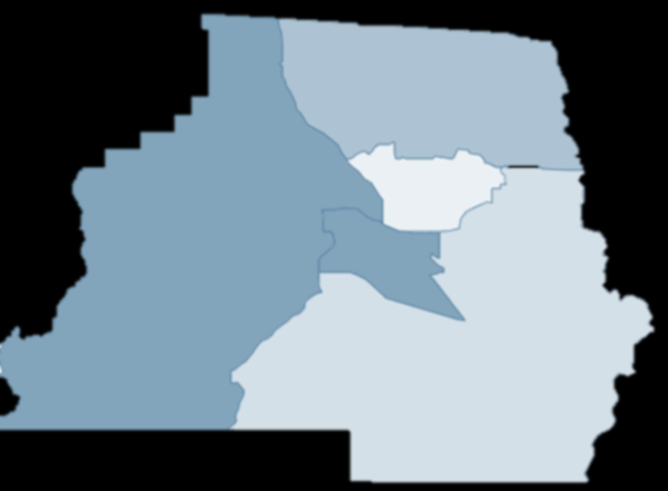

Death Rates Due to Diabetes, 2000 – 2018 Madison County and Florida
Madison County death rates have remained above the state since 2014
2014-2018 diabetes death data by race/ethnicity and gender
54% of deaths were White, non-Hispanic, 43% were Black, non-Hispanic and 3% were Hispanic
65% of deaths were male and 35% were female
Diabetes Death Rates by Census Tract
2014-2018
Highest death rates
due to diabetes
1101
1103.01
1103.02
1102
1103.02
1104

Slide 3
Hospitalization Rates Due to Diabetes (2000 – 2018) Madison County and Florida
Diabetes hospitalization rates in Madison County were lower than the state from 2008-2017
Madison residents may also be seeking hospital care in Georgia, which would account for lower hospitalization rates and higher death rates than the state

Slide 4
Hospitalization Rates Due to Diabetes by Race/Ethnicity (2014 – 2018)
Madison County
The majority of hospitalizations occurred in white, non-Hispanics during the time frame.
This may indicate an access to care issue for racial/ethnic minorities.
Data not available by gender

Slide 5
Risk Factors for Diabetes, Madison County and Florida
Risk Factors | Madison County | Florida
Diabetic | 17% | 11%
Adult Obesity | 34% | 27%
Physically inactive | 31% | 23%
Access to exercise opportunities | 50% | 88%
Limited access to healthy foods | 10% | 7%
Food insecurity | 23% | 14%
2019 Robert Wood Johnson County Health Rankings Data

Slide 6
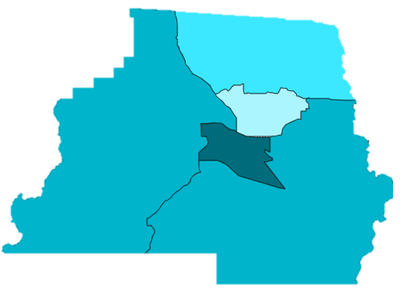
Death Rates Due to Hypertension, 2000-2018 Madison County and Florida
Madison Data 2014-2018
43% of hypertension deaths were male and 57% were female
43% of hypertension deaths were White, non-Hispanic and 57% were Black, non-Hispanic
There were no Hispanic deaths due to hypertension during 2014-2018
Hypertension Death Rates by Census Tract
2014-2018
1101
1103.01
1102
1103.02
1104

Slide 7
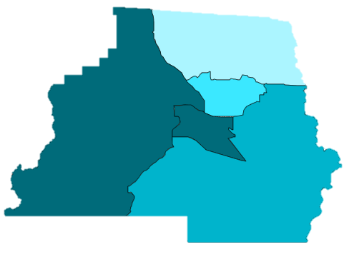
Deaths Rates Due to Heart Attack, 2000-2018 Madison County and Florida
During 2014-2018, more females (55%) died due to heart attack than males (45%)
74% of heart attack deaths were White, non-Hispanic, 43% were Black, non-Hispanic and 0% were Hispanic
Heart Attack Death Rates by Census Tract 2014-2018
Highest death rates
due to heart attack
1101
1103.01
1102
1103.02
1104

Slide 8
Hospitalizations Due to Congestive Heart Failure 2000-2018, Madison County and Florida
Madison County Data 2014-2018
62% of congestive heart failure hospitalizations were White, non-Hispanic and 37% were Black, non-Hispanic
There were 14 Hispanic hospitalizations or 1% of the total
Data are not available by gender

Slide 9
Death Rates Due to Stroke, 2000-2018 Madison County and Florida
The Madison County death rate due to strokes has been higher than the state since 2011
The 2018 death rate per 100,000 population was 58.7, compared to 41.0 for Florida

Slide 10
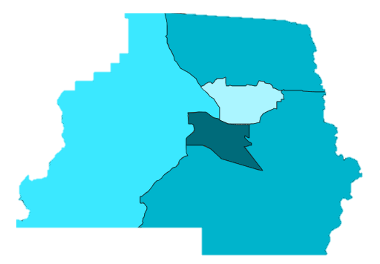
Death Rates Due to Stroke, by Census Tract, Madison County
Madison Data 2014-2018
More females (58%) died due to stroke than males (42%) during this time period
55% of stroke deaths were White, non-Hispanic, 41% were Black, non-Hispanic and 4% were Hispanic
Stroke Deaths by Census Tract 2014-2018
Highest death rate
due to stroke
1101
1103.01
1102
1103.02
1104

Slide 11
Hospitalization Rates Due to Stroke 2000 – 2018, Madison County and Florida
Hospitalizations due to stroke increased in 2018
The 2018 rate for Madison was lower (219.4 per 100,000 population), compared to Florida (231.2)
The 2018 hospitalization rate for non-white persons was 223.5, compared to 199.5 for whites

Slide 12
Risk Factors for Cardiovascular Disease and Stroke (2019 RWJ and 2016 BRFSS)
Indicator | Madison County | Florida
Adult smokers (2019 RWJ) | 19% | 15%
Ever had a stroke (2016 BRFSS) | 7.7% | 3.5%
Ever had coronary heart disease (2016 BRFSS) | 5.5% | 4.7%
Ever had a heart attack (2016 BRFSS) | 6.0% | 5.2%
Inactive or insufficiently active adults (2016 BRFSS) | 57.8% | 56.7%

Slide 13
Cancer Death Rates (2000 – 2018) Madison County and Florida
Death rates due to all cancers have been higher in Madison County than Florida since 2013
Cancer death rates remained almost the same at 146.3 per 100,000 population in 2017 to 146.8 in 2018. Florida’s rates were 149.4 in 2017 and 146.2 in 2018

Slide 14
Cancer Deaths by Type of Cancer (2017 and 2018), Madison County
Type of Cancer | 2017 Deaths | 2018 Deaths
Bladder | 0 | 1
Brain/Central Nervous System | 1 | 1
Colorectal | 3 | 3
Esophageal | 1 | 3
Hodgkin’s Disease | 0 | 1
Benign Neoplasm/Uncertain/Unknown | 2 | 0
Kidney and Renal Pelvis | 0 | 1
Leukemia | 2 | 2
Liver | 3 | 0
Lung | 7 | 12
Lymphoid/Hematopoietic and Related Tissue | 3 | 5

Slide 15
Cancer Deaths by Type of Cancer (2017 and 2018), Madison County (cont’d)
Type of Cancer | 2017 Deaths | 2018 Deaths
Melanoma | 1 | 0
Non-Hodgkin’s Lymphoma | 0 | 2
Oral | 1 | 0
Pancreatic | 1 | 2
Prostate | 6 | 2
Stomach | 3 | 1
Uterine | 0 | 0
Breast | 2 | 1
Cervical | 0 | 0
Ovarian | 0 | 1

Slide 16
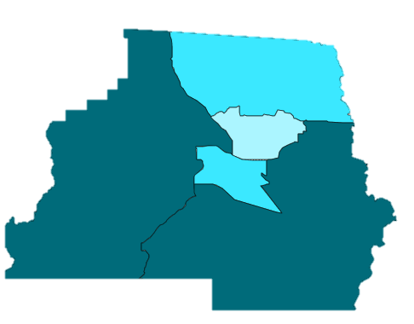
Cancer Death Rates by Census Tract Madison County
Cancer Deaths by Census Tract
2014-2018
For Madison County cancer deaths between 2014-2018, 61% were male and 39% were female
Madison County 2014-2018 cancer deaths by race/ethnicity were 70% White, non-Hispanic, 28% Black, non-Hispanic and 2% Hispanic
1101
1103.01
1102
1103.02
1104
Highest death rates
due to cancer

Slide 17
Tobacco-Related Cancer Death Rates (2000 – 2018), Madison County and Florida
The 2018 death rate due to tobacco-related cancers -70.5 was higher than the state at 63.3
The death rate for non-white persons increased from 29.9 per 100,000 in 2017 to 33.6 in 2018. Death rates for whites increased from 50.2 to 87.6
Data not available by gender
Tobacco related cancers include: Acute myeloblastic leukemia, bladder, bronchus, cervix, esophagus, kidney, lip, lung, oral cavity, pancreas, pharynx, stomach, and trachea

Slide 18
Tobacco Use – Youth Tobacco Survey
Notes:
The percent of students in Madison County admitting to using cigarettes has declined from 9.3% in 2012 to 6.3% in 2016. The 2016 percentage is higher than the state’s percentage of 3.0%
The percent of students in Madison County who stated they currently use smokeless tobacco has increased from 6.2% in 2012 to 6.8% in 2016. The 2016 percentage for the state is 2.2%
The percent of students in Madison County who stated they currently use electronic vaping has increased from 4.8% in 2012 to 11.5% in 2016. The 2016 percentage for the state is slightly higher at 11.6%
The percent of students in Madison County who stated they currently use cigarettes, cigars, smokeless, hookah, or electronic vaping has increased from 17.4% in 2012 to 20.1% in 2016. The state percentage for 2016 is 16.3%.

Slide 19
Colorectal Cancer Death Rates (2000 – 2018), Madison County and Florida
Madison Data 2014-2018
Total of 19 deaths due to colorectal cancer
12, or 63% were White, non-Hispanic and 7, or 37% were Black, non-Hispanic
8, or 42% were Male and 11, or 58% were Female
There were no Hispanic deaths during the time frame

Slide 20
Melanoma Death Rates (2000 – 2017) 3-Year Discrete, Madison County and Florida
Madison 2000-2017
Total of 12 deaths due to melanoma
10, or 83% were White, non-Hispanic and 2, or 17% were Black, non-Hispanic
7, or 58% were Male and 5, or 42% were Female
There were no Hispanic deaths during the time frame

Slide 21
Percent of Adults Who Were Told They Had Skin Cancer, 2016 BRFSS, Madison County
 | Category | 2016 Percent | 2013 Percent
 | Total | 12.2 | 7.9
Gender | Men | 12.3 | 8.4
 | Women | 12.2 | 7.5
Race/Ethnicity | NH White | 17.9 | 13.1
 | NH Black | 0.9 | 0.8
Age Group | 18-44 | 1.8 | 2.1
 | Age 45-64 | 8.8 | 7.7
 | Age 65+ | 23.9 | 20.7
Income | <$25,000 | 8.1 | 4.3
 | $25,000-$49,000 | 17.0 | 8.6
 | $50,000+ | 14.9 | 10.1

Slide 22
Chronic Liver Disease and Cirrhosis Death Rates (1999 – 2019) Madison County and Florida
Madison 1999-2019
Total of 44 deaths
31 (70%) were White, non-Hispanic, 9 (21%) were Black, non-Hispanic and 4 (9%) were unknown
28 (64%) were Male and 16 (36%) were Female
0 Hispanic deaths reported
Notes:
Only 11.6% of BRFSS participants responded that they engaged in heavy drinking in 2016, compared to 17.5% for Florida.

