Slide 1
MORTALITY DATA &
Infectious & Reportable Disease
Data Source: DOH Florida CHARTS
Presentation developed by: Pam Beck, Operations Manager, Department of Health-Madison
Presented by: Dr. Daniel Perkins, Chief Medical Officer, Madison County Memorial Hospital

Slide 2

10 Leading Causes of Death 2018, Madison County
Cause of Death | Deaths | Percent of Total
Heart Diseases | 65 | 34%
Malignant Neoplasm (Cancer) | 41 | 22%
Cerebrovascular Diseases | 16 | 8%
Chronic Lower Respiratory Disease | 15 | 8%
Unintentional Injury | 14 | 7%
Nephritis, Nephrotic Syndrome, Nephrosis | 9 | 5%
Diabetes Mellitus | 7 | 4%
Essen Hypertension and Hypertensive Renal Disorder | 6 | 3%
Influenza and Pneumonia | 5 | 3%
Alzheimer’s Disease | 4 | 2%
Chronic Liver Disease and Cirrhosis | 4 | 2%
Septicemia | 4 | 2%
Each
had 4
deaths

Slide 3
Leading Causes of Infant Mortality
Madison County, 2014-2018 Combined
Cause of Death (N=10) | Percent of Total Deaths
Disorders Related to Short Gestation and Low Birth Weight | 30%
Sudden Infant Death Syndrome (SIDS) | 20%
Newborn Affected by Maternal Complications of Pregnancy | 20%
Other Non-rankable Cause of Death | 20%
Renal Failure and Other Kidney Disorders | 10%

Slide 4
2019 Robert Wood Johnson County Health Ranking Data, Madison County
Life expectancy for Madison County is 76, compared to 80 for Florida
Child mortality rate is twice that of Florida
Motor vehicle crash death rates are more than twice that of Florida
The rate of preventable hospital stays is higher for Madison than Florida

Slide 5
REPORTABLE, INFECTIOUS DISEASES
Data Source: DOH Florida CHARTS, Bureau of Communicable Diseases

Slide 6
HIV Infection 3-Year Rolling Rates
(2000/02 – 2016/18)
Reported HIV cases increased from 2 in 2017 to 5 in 2018
Of the 15 HIV cases reported during 2014-2018
  80% were Black, non-Hispanic
  13% were Hispanic
  7% were White, non-Hispanic
  66% were Male and 33% were female

Slide 7
Reported AIDS Rates & Cases, by Race/ Ethnicity (2000 – 2018), Madison County
Madison County experienced an increase in the AIDS rate in 2018
Black, non-Hispanic persons account for 40% of the Madison population and 93% of the AIDS cases reported since 2000

Slide 8
Chlamydia Case Rates, by Year & ages 15-19
(2006 – 2018), Madison County and Florida
Chlamydia cases increased from 82 in 2017 to 92 in 2018
The 2018 Madison County chlamydia rate per 100,000 population was 160.4 for white, NH, 875.5 for black, NH, and 186.2 for Hispanics
Madison County 2018 chlamydia case rates per 100,000 among females ages 15-19 are 2,577.3 for white, NH, 3,650.4 for black, NH and 6,896.6 for Hispanics

Slide 9
Gonorrhea Case Rates by Year & ages 15-19 (2006 – 2018) Madison County and Florida
Madison County number of gonorrhea cases increased from 30 in 2017 to 45 in 2018
Madison’s rate per 100,000 population in 2018 was 45.3 for white, NH, 162.7 for black, NH and 0.0 Hispanics
Madison County 2018 gonorrhea rate per 100,000 females ages 15-19 was 515.5 for white, NH and 3,500.0 for black, NH. There were no Hispanic females ages 15-19 diagnosed in 2018

Slide 10
Other Reportable Diseases or Conditions
Data Source: DOH Florida CHARTS, Bureau of Epidemiology

Slide 11
Other Reportable Diseases or Conditions, 2000-2018, Madison County
Disease or Condition and Definition | # Cases | Comments
Camplobacteriosis | 21
Haemophilus influenzae Invasive Disease – a bacterial infection that can cause anything from mild ear infections to bloodstream infections | 5 | 2 cases reported in 2017
Meningitis, Bacterial or Mycotic - A bacterial or viral infection of the fluid surrounding the brain and spinal cord that causes swelling of the membranes covering the brain and spinal cord | 1
Giardiasis, Acute | 17
Streptococcus pneumoniae Invasive Disease – this bacteria can cause many types of illnesses, including ear infections and meningitis | 6 | 1 case reported in 2018
Shigellosis | 29
Salmonellosis | 71
Cryptosporidiosis | 8
Shiga Toxin Producing Escherichia coli | 3

Slide 12
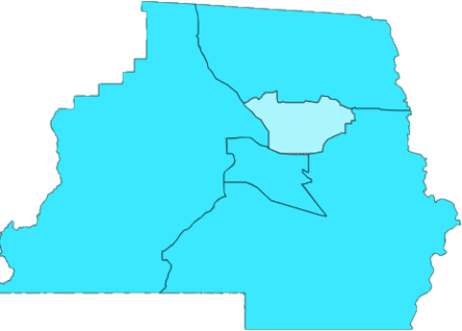
Influenza and Pneumonia Deaths by
Census Tract, 2014-2018, Madison County
Total deaths = 22
Census tract 1103.01 had two deaths during the time period
All other census tracts had five deaths during the time period
Breakdown by race/ethnicity
  16 White, non-Hispanic
  6 Black, non-Hispanic
  0 Hispanic
9 Males, 13 Females
1101
1103.01
1102
1103.02
1104

Slide 13
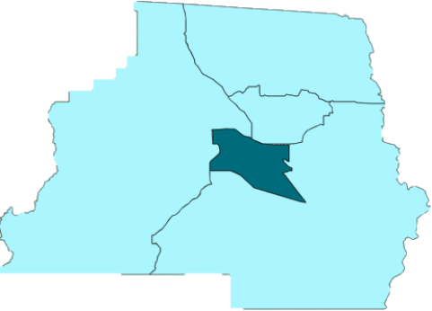
Septicemia Deaths by Census Tract
2014-2018, Madison County
Breakdown by census tract (1 unknown)
  1101 = 2
  1102 = 2
  1103.01 = 2
  1103.02 = 6
  1104 = 2
Breakdown by race/ethnicity
  5 White, non-Hispanic
  12 Black, non-Hispanic
  0 Hispanic
7 Males, 8 Females
1101
1103.01
1102
1103.02
1104

Slide 14
Tuberculosis in Madison County, 2000-2018
There were 13 tuberculosis cases diagnosed in Madison County between 2000 and 2018, including one in 2018
Data are not available by race/ethnicity or gender
There were no cases of tuberculosis in children under the age of 15 during the time period
There was one death from tuberculosis in Madison County in 2000

Slide 15
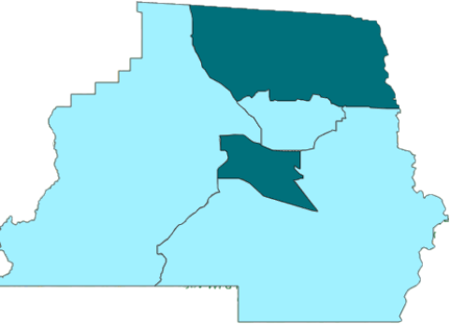
Viral Hepatitis Deaths 2014-2018, Madison
Hepatitis A
  3 Hepatitis A cases
Hepatitis B
  6 acute Hepatitis B cases
  20 chronic Hepatitis B cases
  0 Perinatal Hepatitis B cases
  3 reported positive Hepatitis B Surface Antigen Results in Pregnant Women
Hepatitis C
  0 acute Hepatitis C cases
  212 chronic Hepatitis C cases
Census tracts 1101 and 1103.02 each had 1 death due to viral hepatitis
2 Males, 0 Females
1101
1103.01
1102
Breakdown by race/ethnicity
  1 White, NH
  1 Black, NH
  0 Hispanic
1103.02
1104
No cases of Hepatitis D, E or G reported in Madison County since data collection in 2006
Data Not Available by Race or Gender

Slide 16
Vaccine Preventable Diseases
2000-2018, Madison County
Pertussis – 1 case reported in 2013 and 1 case reported in 2014
Varicella (Chickenpox) - 1 case each reported in 2013, 2014 and 2017
Meningococcal disease - 1 case in 2006
No cases of the following diseases since 1996
    Diphtheria
    Measles
    Mumps
    Poliomyelitis
    Rubella
    Tetanus

Slide 17
Environmental Health
Data Source: DOH Florida CHARTS, Bureau of Epidemiology

Slide 18
Asthma, Madison County
There have been four deaths due to asthma during 2000-2017. Of these, two were Black, non-Hispanic males and two were White, non-Hispanic females
There have been 149 hospitalizations due to asthma in ages 1-5 during 2000-2017. There were none in this age group for 2016 and 2017.
There have been 51 hospitalizations due to asthma in ages 12-18 during 2000-2017. There were five in 2016 and none in 2017.

Slide 19
Environmental Conditions, 2008-2018
Madison County
Disease or Condition | Cases
Arsenic Poisoning | 0
Carbon Monoxide Poisoning | 0
Lead Poisoning | 3
Mercury Poisoning | 0
Pesticide Related Illness and Injury | 2
Ricin Toxin Poisoning | 0
Unsatisfactory facility inspections 2017
  12 of 30 biomedical waste facilities (40%)
  1 of 23 group care facilities (4.3%)
  5 of 61 institutional food service operations (13.1%)
  8 of 66 mobile home and RV parks (12.7%)
  3 of 23 swimming pool and spa facilities (13%)
  No body piercing facilities, tanning facilities, or labor camps
Data are not available by race/ethnicity or gender

